Slide 1
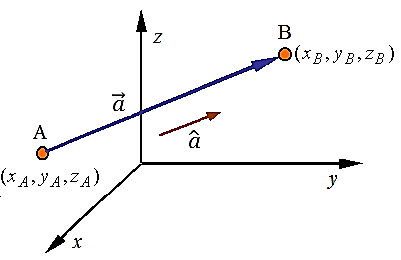
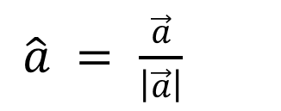


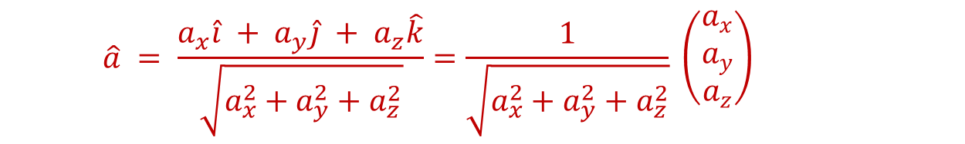
Unit vector
Definition
It gives direction only!
A unit vector is a vector whose length is 1.
For a vector $\vec{a}$, a unit vector is in the
same direction as $\vec{a}$ and is given by:
$\hat{a} =$ $\frac{\vec{a}}{\left|\vec{a}\right|}$
$$\begin{matrix}a_{x}=(x_{B}−x_{A}) \\ a_{y}=(y_{B}−y_{A}) \\ a_{z}=(z_{B}−z_{A})\end{matrix}$$
$$\hat{a} = \frac{a_{x}\hat{i} + a_{y}\hat{j} + a_{z}\hat{k}}{\sqrt{a_{x}^{2}+a_{y}^{2}+a_{z}^{2}}}=\frac{1}{\sqrt{a_{x}^{2}+a_{y}^{2}+a_{z}^{2}}} \left(\begin{matrix}a_{x} \\ a_{y} \\ a_{z}\end{matrix}\right)$$

Slide 2
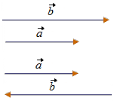
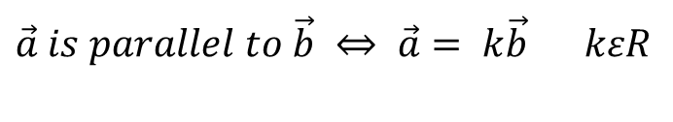
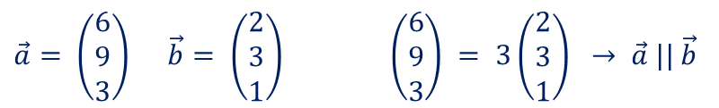
PARALLEL and COLLINEAR VECTORS
$\vec{a} is parallel to \vec{b} ⇔ \vec{a}= k\vec{b}$ $kεR$
$\vec{a}= \left(\begin{matrix}6 \\ 9 \\ 3\end{matrix}\right) \vec{b}= \left(\begin{matrix}2 \\ 3 \\ 1\end{matrix}\right)$ $\left(\begin{matrix}6 \\ 9 \\ 3\end{matrix}\right) = 3\left(\begin{matrix}2 \\ 3 \\ 1\end{matrix}\right) → \vec{a} || \vec{b}$
$$Points are collinear if they lie on the same line$$
$A, B and C are collinear$ $⇔$ $\vec{AB}=k\vec{AC} for some scalar k$
$$(one common point and the same direction)$$

Slide 3

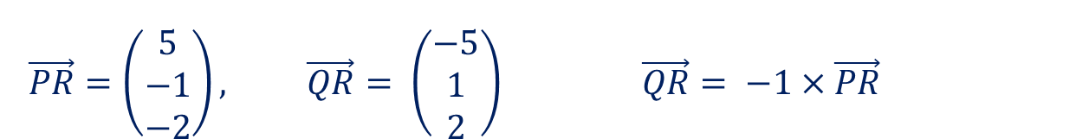
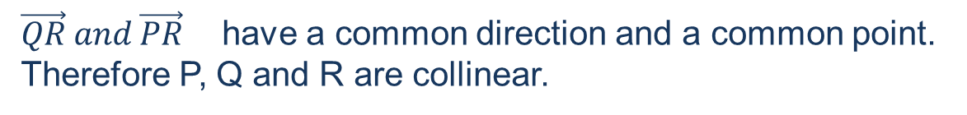
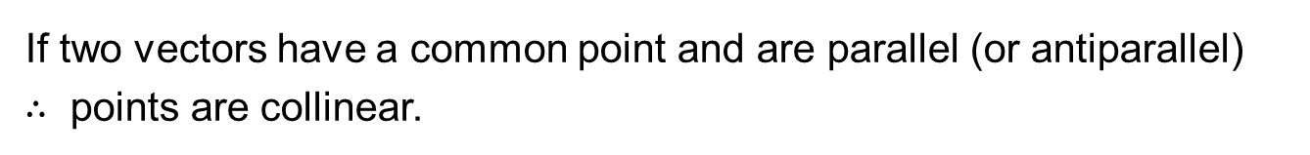
ARE 3 POINTS COLLINEAR ?
How can you check it:
Form two vectors with these three points.
They will definitely have one common point.
Check if these two vectors are parallel.
If two vectors have a common point and are parallel (or antiparallel)
$∴$ points are collinear.
Show that P(0, 2, 4), Q(10, 0, 0) and R(5, 1, 2) are collinear.
$$\vec{PR}=\left(\begin{matrix}5 \\ −1 \\ −2\end{matrix}\right), \vec{QR}= \left(\begin{matrix}−5 \\ 1 \\ 2\end{matrix}\right) \vec{QR}= −1×\vec{PR}$$
$\vec{QR} and \vec{PR}$ have a common direction and a common point.
Therefore P, Q and R are collinear.

Slide 4

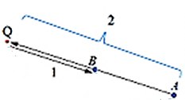

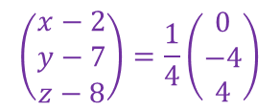
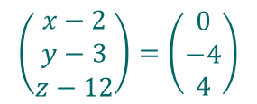

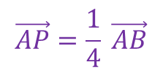

THE DIVISION OF A LINE SEGMENT
X divides [AB]$≡\overline{\text{AB}}$ in the ratio $a:b$ means $\vec{AX}:\vec{XB}=a :b$
A = (2, 7, 8) B = ( 2, 3, 12)
INTERNAL DIVISION
$$\vec{AP}=\frac{1}{4} \vec{AB}$$
P divides [AB] internally
in ratio 1:3. Find P
$$\left(\begin{matrix}x−2 \\ y−7 \\ z−8\end{matrix}\right)=\frac{1}{4}\left(\begin{matrix}0 \\ −4 \\ 4\end{matrix}\right)$$
$$\vec{AP}:\vec{PB}=1:3 → \vec{AP}=\frac{1}{4} \vec{AB}$$
point P is (2, 6, 9)
EXTERNAL DIVISION
X divide [AB] externally in ratio 2:1,
or
X divide [AB] in ratio –2:1. Find Q
$$\vec{BQ}=\vec{AB}$$
$$\left(\begin{matrix}x−2 \\ y−3 \\ z−12\end{matrix}\right)=\left(\begin{matrix}0 \\ −4 \\ 4\end{matrix}\right)$$
$$\vec{AQ}:\vec{QB}=−2:1$$
point Q is (2,– 1,16)

Slide 5
lines
A line is completely determined by a fixed point and its direction.
Using vectors gives us a very neat way of writing down an equation which gives the position vector of any point P on a given straight line. This method works equally well in two or three dimensions.

Slide 6
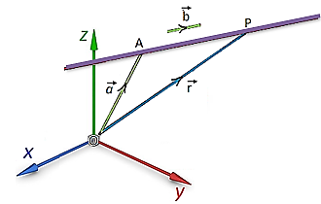

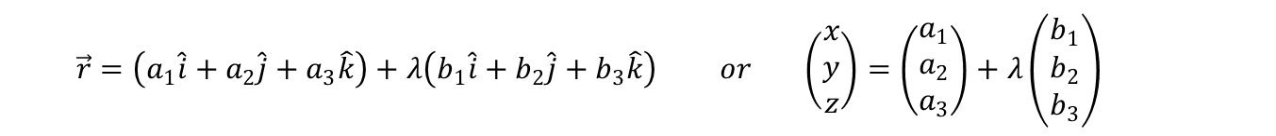
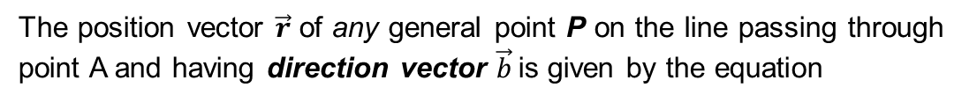

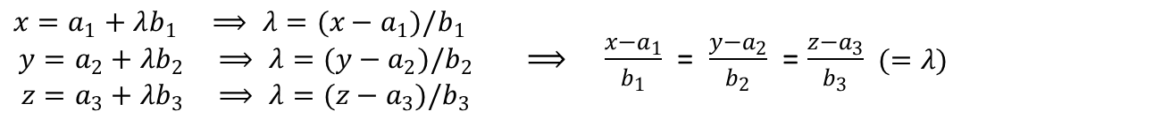
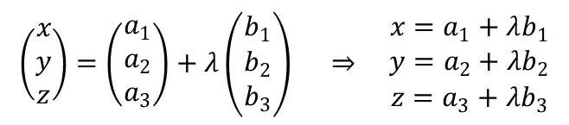
LINE EQUATION IN 2 – D and 3 – D COORDINATE SYSTEM
● Vector equation of a line
The position vector $\vec{r}$ of any general point P on the line passing through point A and having direction vector $\vec{b}$is given by the equation
$$\vec{r}=\vec{a}+t \vec{b} t∈R$$
IB Convention: $use t for 2−D line$
$λ for 3−D line$
$$\vec{r}=\left(a_{1}\hat{i}+a_{2}\hat{j}+a_{3}\hat{k}\right)+λ\left(b_{1}\hat{i}+b_{2}\hat{j}+b_{3}\hat{k}\right) or \left(\begin{matrix}x \\ y \\ z\end{matrix}\right)=\left(\begin{matrix}a_{1} \\ a_{2} \\ a_{3}\end{matrix}\right)+λ\left(\begin{matrix}b_{1} \\ b_{2} \\ b_{3}\end{matrix}\right)$$
● Parametric equation of a line – λ is called a parameter λ $∈ R$
$$\left(\begin{matrix}x \\ y \\ z\end{matrix}\right)=\left(\begin{matrix}a_{1} \\ a_{2} \\ a_{3}\end{matrix}\right)+λ\left(\begin{matrix}b_{1} \\ b_{2} \\ b_{3}\end{matrix}\right) ⇒ \begin{matrix}x=a_{1}+λb_{1} \\ y=a_{2}+λb_{2} \\ z=a_{3}+λb_{3}\end{matrix}$$
● Cartesian equation of a line
$\begin{matrix}x=a_{1}+λb_{1} ⟹ λ=(x−a_{1})/b_{1} \\ y=a_{2}+λb_{2} ⟹ λ=(y−a_{2})/b_{2} \\ z=a_{3}+λb_{3} ⟹ λ=(z−a_{3})/b_{3}\end{matrix}$ ⟹ $\frac{x−a_{1}}{b_{1}}$ =$\frac{y−a_{2}}{b_{2}}$ =$\frac{z−a_{3}}{b_{3}}$ $(=λ)$

Slide 7
Find the equation of the line passing through the points A(3, 5, 2) and B(2, -4, 5).
Find the direction of the line:
One possible direction vector is
The Cartesian equation of this line is
(using the coordinates f point A).
The equivalent vector equation is

Slide 8
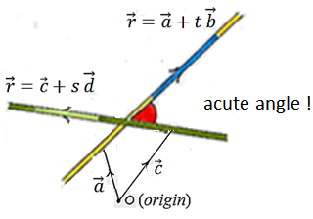

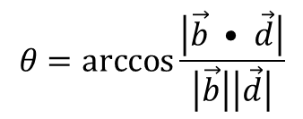
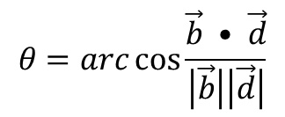
ANGLE BETWEEN TWO LINES
$$θ=\arccos{\frac{\left|\vec{b} • \vec{d}\right|}{\left|\vec{b}\right|\left|\vec{d}\right|}}$$
Two vectors
$$θ=arc\cos{\frac{\vec{b} • \vec{d}}{\left|\vec{b}\right|\left|\vec{d}\right|}}$$

Slide 9
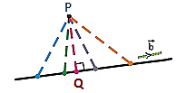

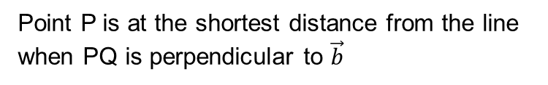

Shortest distance from a point to a line
Point P is at the shortest distance from the line
when PQ is perpendicular to $\vec{b}$
$$∴ \vec{PQ}•\vec{b}=0$$
Find the shortest distance between $\vec{r}=\left(\begin{matrix}1 \\ 3 \\ 1\end{matrix}\right)+λ\left(\begin{matrix}2 \\ 3 \\ 2\end{matrix}\right)$ and point P (1,2,3).
(The goal is to find Q first, and then $\left|\vec{PQ}\right|$)
Point Q is on the line, hence its coordinates must satisfy line equation:
$$\left(\begin{matrix}x_{Q} \\ y_{Q} \\ z_{Q}\end{matrix}\right)=\left(\begin{matrix}1+2λ \\ 3+3λ \\ 1+2λ\end{matrix}\right)⇒\vec{PQ}=\left(\begin{matrix}2λ \\ 1+3λ \\ −2+2λ\end{matrix}\right)$$
$$⇒\left(\begin{matrix}2λ \\ 1+3λ \\ −2+2λ\end{matrix}\right)•\left(\begin{matrix}2 \\ 3 \\ 2\end{matrix}\right)=0$$
$$⇒ 4λ+3+9λ−4+4λ=0 ⇒ 17 λ=1 ⇒λ=\frac{1}{17}$$
$⇒$ $\vec{PQ}=\left(\begin{matrix}2/17 \\ 20/17 \\ 32/17\end{matrix}\right) ⇒find \left|\vec{PQ}\right|$

Slide 10
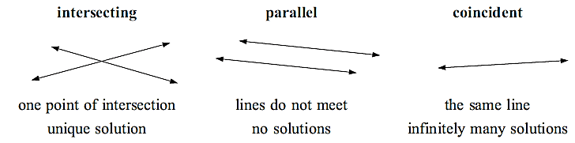
Relationship between lines
2 – D:
3 – D:
● the lines are coplanar (they lie in the same plane). They could be:
▪ intersecting ▪ parallel ▪ coincident
● the lines are not coplanar and are therefore skew
(neither parallel nor intersecting)

